Slide 1
Modern Linux Tracing Landscape
Sasha Goldshtein
CTO, Sela Group
github.com/goldshtn
@goldshtn

Slide 2
Agenda
Overview of kernel tracing technologies
Modern tracing tools
BPF: The next Linux tracing superpower

Slide 3
What Is Tracing, Exactly?
Inspect function execution, arguments, call graph
Print lightweight log messages (kernel/user)
Aggregate statistics (min/max/avg, histogram)
Low overhead
Continuous monitoring

Slide 4
Linux Tracing Tools
Ease of use
dtrace for Linux
ply/BPF
SysDig
ktap
LTTng
perf
SystemTap
ftrace
bcc/BPF
C/BPF
new
stable
dead
custom .ko
Level of detail, features
Notes:
Shading:
green = relatively new, not fully mature, progressing quickly
red = dead, dying, has issues
blue = mature, stable
Arrows indicate direction of development (towards ease of use and or features)

Slide 5
Tracepoints
Trace statements compiled to a function that does nothing
Optionally attached to a probe handler that prints/counts/…
TRACE_EVENT, DEFINE_EVENT_CLASS, DEFINE_EVENT
Documentation/trace/tracepoints.txt
Also available for user mode with USDT, #include <sys/sdt.h>
TRACE_EVENT(sched_switch,
TP_PROTO(bool preempt, struct task_struct *prev, ...),
TP_ARGS(preempt, prev, next),
...

Slide 6
ftrace
Kernel functions are instrumented with calls to mcount (gcc -pg)
Tracer calls replaced with nops at boot time
Patched back to call ftrace on demand
Can get function execution trace, call graph, call stack
Main interface through /sys/kernel/debug/tracing
Documentation/trace/ftrace.txt

Slide 7
kprobes and uprobes
Place a probe on any instruction in any function
Replaced with breakpoint or with jump if possible
Handler (typically .ko) can run before and after
kprobe, jprobe, kretprobe (same for user)
Documentation/kprobes.txt
Documentation/trace/uprobetracer.txt
push ebp
mov ebp, esp
sub esp, 8
...
...
...
mov esp, ebp
pop ebp
ret
Notes:
Demo
Poor-man’s opensnoop:
cd /sys/kernel/debug/tracing
echo 1 > tracing_on
echo ‘p:myprobe do_sys_open filename=+0(%si):string’ > kprobe_events
echo 1 > events/kprobes/myprobe/enable
cat trace_pipe

Slide 8
perf_events
Standard Linux profiler
Provides the perf command
Usually a package added by linux-tools-common, etc.
Many event sources:
Timer-based sampling
Hardware events (e.g. LLC misses)
Tracepoints (e.g. block:block_rq_complete)
Dynamic tracing (kprobes, uprobes)
Can sample stacks of (almost) everything on CPU
Can miss hard interrupt ISRs, but these should be near-zero and can be measured separately if needed

Slide 9
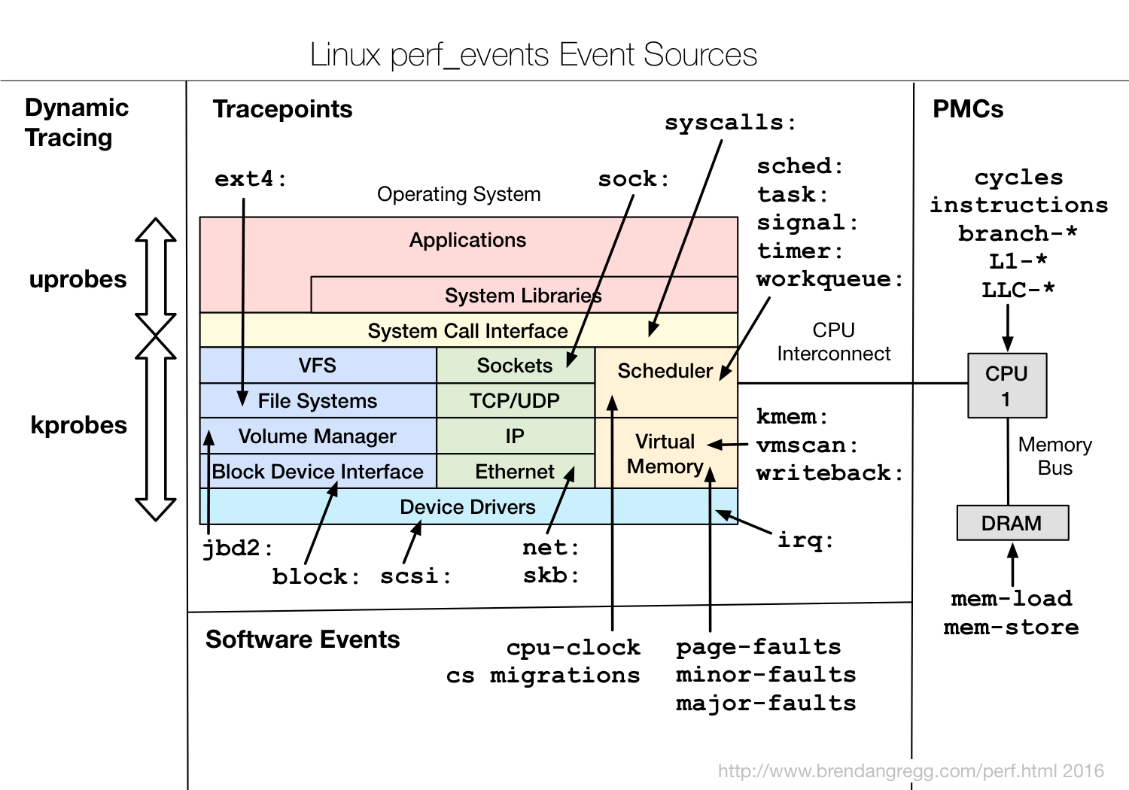

Slide 10
perf
Developed in-tree and actively maintained, new features landing often
Multi-tool for a variety of performance investigations
Records into perf.data for post-processing
# perf
usage: perf [--version] [--help] [OPTIONS] COMMAND [ARGS]
The most commonly used perf commands are:
annotate Read perf.data (created by perf record) and display annotated code
archive Create archive with object files with build-ids found in perf.data
bench General framework for benchmark suites
buildid-cache Manage build-id cache.
buildid-list List the buildids in a perf.data file
config Get and set variables in a configuration file.
data Data file related processing
diff Read perf.data files and display the differential profile
evlist List the event names in a perf.data file
inject Filter to augment the events stream with additional information
kmem Tool to trace/measure kernel memory properties
kvm Tool to trace/measure kvm guest os
list List all symbolic event types
lock Analyze lock events
mem Profile memory accesses
record Run a command and record its profile into perf.data
report Read perf.data (created by perf record) and display the profile
sched Tool to trace/measure scheduler properties (latencies)
script Read perf.data (created by perf record) and display trace output
stat Run a command and gather performance counter statistics
test Runs sanity tests.
timechart Tool to visualize total system behavior during a workload
top System profiling tool.
probe Define new dynamic tracepoints
trace strace inspired tool
See 'perf help COMMAND' for more information on a specific command.

Slide 11
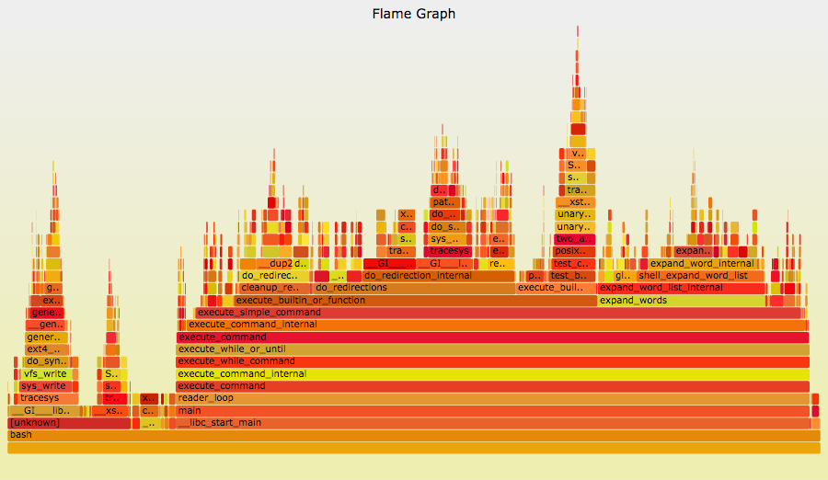
Flame Graphs
A visual approach for summarizing stack traces
Flame graphs:
x-axis: alphabetical stack sort, to maximize merging
y-axis: stack depth
color: random (default), or a dimension
Currently made from Perl + SVG + JavaScript
https://github.com/brendangregg/FlameGraph
Multiple d3 versions are also being developed
Easy to make
Converters for many profilers
Notes:
Demo
CPU profiling with flame graphs
perf record -F 97 -ag -- sleep 5
perf script | FlameGraph/stackcollapse-perf.pl | FlameGraph/flamegraph.pl > flame.svg

Slide 12
Berkeley Packet Filters (BPF)
Originally designed for, well, packet filtering: dst port 80 and len >= 100
Custom instruction set, interpreted/JIT compiled
0: (bf) r6 = r1
1: (85) call 14
2: (67) r0 <<= 32
3: (77) r0 >>= 32
4: (15) if r0 == 0x49f goto pc+40

Slide 13
Extended BPF
Used for virtual network, security, tracing
Multiple front-ends: C, perf, SystemTap, bcc, ply, …
User Program
Kernel
1. generate
verifier
BPF bytecode
kprobes
BPF
2. load
uprobes
per-event
data
3. perf_output
tracepoints
3. async
read
statistics
maps

Slide 14

BCC: BPF Compiler Collection
Library and Python/Lua module for compiling, loading, and executing BPF programs
https://github.com/iovisor/bcc
C + Python/Lua front-end for BPF
Includes many tracing tools
Tracing layers:
bcc tool
bcc tool
…
bcc
…
Python
lua
U
K
front-ends
Kernel
BPF
Events

Slide 15
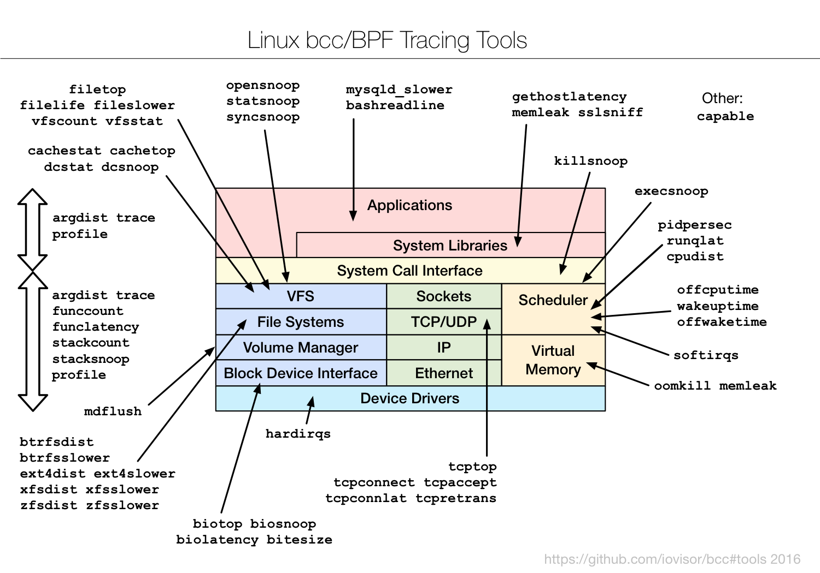

Slide 16
BCC Tools
$ ls *.py argdist.py bashreadline.py biolatency.py biosnoop.py biotop.py bitesize.py btrfsdist.py btrfsslower.py cachestat.py cachetop.py capable.py cpudist.py dcsnoop.py dcstat.py execsnoop.py ext4dist.py ext4slower.py filelife.py fileslower.py filetop.py funccount.py funclatency.py gethostlat...py hardirqs.py killsnoop.py llcstat.py mdflush.py memleak.py offcputime.py offwaketime.py oomkill.py opensnoop.py pidpersec.py profile.py runqlat.py softirqs.py solisten.py stackcount.py stacksnoop.py statsnoop.py syncsnoop.py tcpaccept.py tcpconnect.py tcpconnlat.py tcpretrans.py tplist.py trace.py vfscount.py vfsstat.py wakeuptime.py xfsdist.py xfsslower.py zfsdist.py zfsslower.py

Slide 17
BCC General Performance Checklist
execsnoop
opensnoop
ext4slower (or btrfs*, xfs*, zfs*)
biolatency
biosnoop
cachestat
tcpconnect
tcpaccept
tcpretrans
gethostlatency
runqlat
profile
Notes:
Demo
biolatency (while running dd)
fileslower 0
execsnoop
stackcount t:sched:sched_switch
trace 'r:/usr/bin/bash:readline "%s", retval’
trace -p $(pidof node) 'u:node:http__server__request "%s %s (from %s:%d)" arg5, arg6, arg3, arg4’
ustat
ucalls -SL 10 -l java
uobjnew ruby $(pidof irb)

Slide 18
Summary
Tracing can identify bugs and performance issues that no debugger or profiler can catch
Tools make low-overhead, dynamic, production tracing possible
Flame graphs help visualize complex stack trace information and other hierarchical data
BPF is the next-generation backend for Linux tracing tools

Slide 19
References
Perf and flame graphs
https://perf.wiki.kernel.org/index.php/Main_Page
http://www.brendangregg.com/flamegraphs.html
BPF/BCC tutorials (by Brendan Gregg)
https://github.com/iovisor/bcc/blob/master/docs/tutorial.md
https://github.com/iovisor/bcc/blob/master/docs/tutorial_bcc_python_developer.md
https://github.com/iovisor/bcc/blob/master/docs/reference_guide.md
ftrace, perf, and (mostly) BPF hands-on labs (by Sasha Goldshtein)
https://github.com/goldshtn/linux-tracing-workshop
BPF
https://github.com/torvalds/linux/tree/master/samples/bpf
https://www.kernel.org/doc/Documentation/networking/filter.txt
https://github.com/iovisor/bpf-docs

Slide 20
Thank You!
Sasha Goldshtein
CTO, Sela Group
sashag@sela.co.il
github.com/goldshtn
@goldshtn
blog.sashag.net

